Slide 1
Software construction lab 11:
Code Refactoring

Slide 2
Outcomes:
After doing this lab student will be able to do:
Code Readability Appreciation:
Code Smells Recognition:
Best Practices Application:
Utilizing Built-in Functions:
Performance Optimization:
Debugging and Maintenance Enhancement:
Code Collaboration Promotion:
Time Complexity Considerations:
Confidence in Refactoring:
Code Refactoring Mindset Development:

Slide 3
Introduction to code refactoring:
Introduction to Code Refactoring:
Code refactoring is like giving your code a makeover—it's the process of restructuring and optimizing existing code without changing its external behavior. Just as we tidy up our living spaces for better functionality and aesthetics, refactoring enhances code readability, maintainability, and overall efficiency. It's not about adding new features; it's about making the existing ones shine.
The main purpose of refactoring is to fight technical debt. It transforms a mess into clean code and simple design.

Slide 4
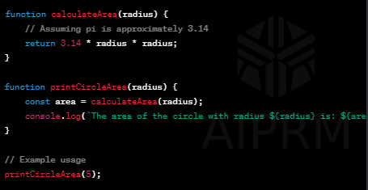
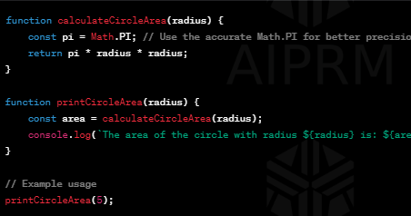
How refactoring works:
In the refactored code:
Improved Function Naming:
The function name calculateCircleArea is more descriptive, making it easier to understand its purpose.
Use of Accurate Constant:
Instead of assuming the value of pi, we use Math.PI for better precision.
Modularization:
The logic for calculating the circle area is separated into a dedicated function, promoting code organization and reusability.

Slide 5
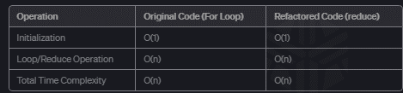
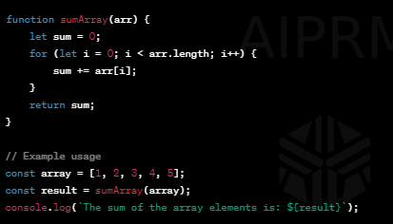
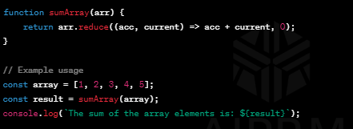
Another example:
In this case, the refactored code uses the reduce method to calculate the sum of array elements. The time complexity of both implementations is O(n), where n is the length of the array.
However, the refactored code is more concise and leverages the built-in reduce method, potentially leading to better performance in some JavaScript engines. The internal implementation of reduce may be optimized in a way that provides better performance compared to a manual loop.

Slide 6
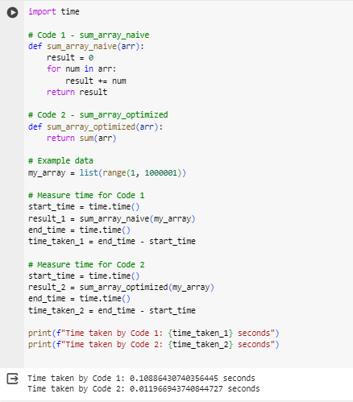
Refactoring with respect to time complexity:
sum is the built-in function that takes an iterable (in this case, the array arr) and returns the sum of its elements. Using built-in functions can often lead to more concise and efficient code.
Notes:
import time
# Code 1 - sum_array_naive
def sum_array_naive(arr):
result = 0
for num in arr:
result += num
return result
# Code 2 - sum_array_optimized
def sum_array_optimized(arr):
return sum(arr)
# Example data
my_array = list(range(1, 1000001))
# Measure time for Code 1
start_time = time.time()
result_1 = sum_array_naive(my_array)
end_time = time.time()
time_taken_1 = end_time - start_time
# Measure time for Code 2
start_time = time.time()
result_2 = sum_array_optimized(my_array)
end_time = time.time()
time_taken_2 = end_time - start_time
print(f"Time taken by Code 1: {time_taken_1} seconds")
print(f"Time taken by Code 2: {time_taken_2} seconds")

Slide 7



Benefits of code refactoring:
Enhanced Readability:
Refactored code is like a well-organized book. It's easier for developers to read and understand, fostering collaboration and reducing the learning curve.
Maintainability Boost:
Refactoring simplifies complex code, making it easier to maintain. It's like having a well-maintained car—less prone to breakdowns and easier to fix when issues arise.
Bug Reduction:
By cleaning up code, refactoring helps uncover and fix hidden bugs. It's akin to renovating a house and finding and fixing those small leaks before they turn into major issues.

Slide 8
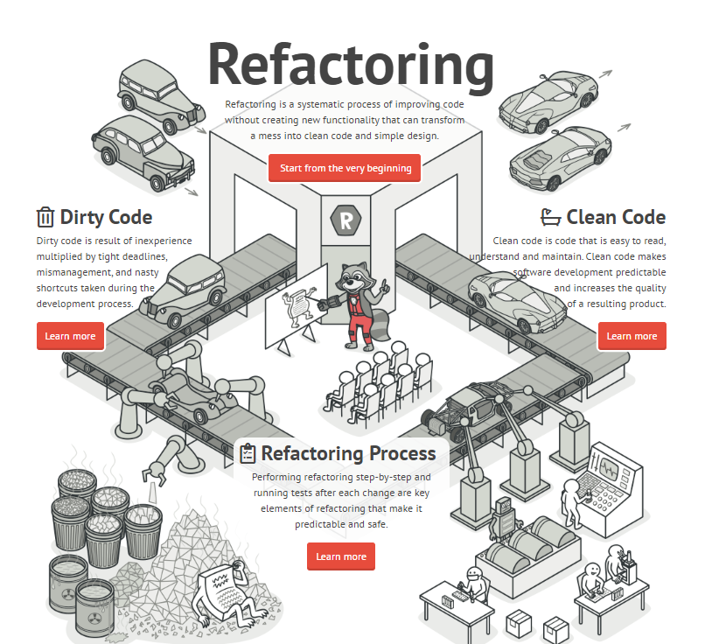
Refactoring:

Slide 9
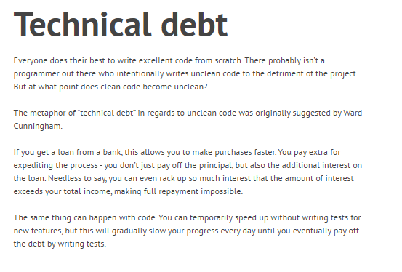
Technical debt:

Slide 10
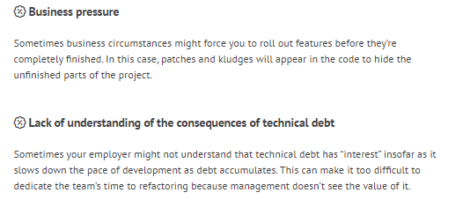
Causes of technical debt

Slide 11
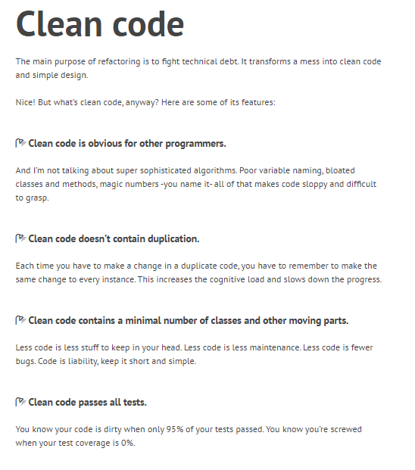
Clean code:

Slide 12
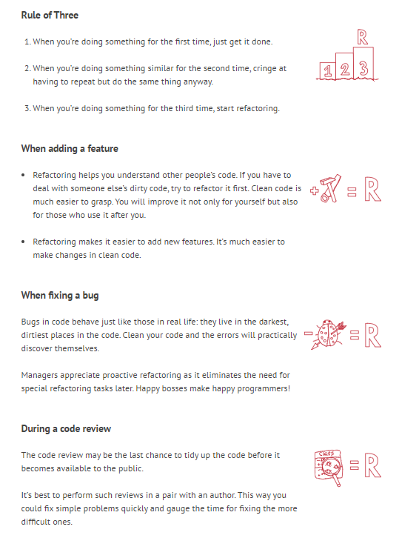
When to refactor:

Slide 13
Code smell:
Code Smell:
Code smell refers to certain patterns in code that may indicate the presence of deeper issues, much like a bad odor suggesting an underlying problem. These are not bugs or errors but rather indicators that the code might need refactoring to improve its design, readability, or maintainability.

Slide 14


Types of code smell:
Duplicated Code:
Description: Repeated chunks of code in different parts of the system.
Impact: Maintenance challenges, as changes may need to be applied in multiple places.
Long Method:
Description: A function or method that is excessively long.
Impact: Reduced readability and maintainability; harder to understand and troubleshoot.
Large Class:
Description: A class with a vast number of methods and attributes.
Impact: Decreased cohesion, making it harder to understand and maintain the class.

Slide 15

Continue…
Shotgun Surgery:
Description: A small change in one part of the codebase requires changes in many other parts.
Impact: High maintenance overhead and increased risk of introducing bugs.
Comments:
Description: Excessive or misleading comments in the code.
Impact: May indicate unclear code that needs improvement in readability.
Lazy Class:
Description: A class that doesn't do enough to justify its existence.
Impact: Adds unnecessary complexity; better handled by incorporating its functionality elsewhere.

Slide 16
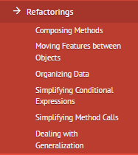
Refactoring techniques:

Slide 17


Composing methods:

Slide 18
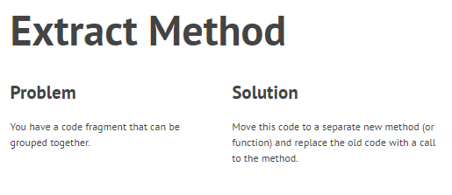
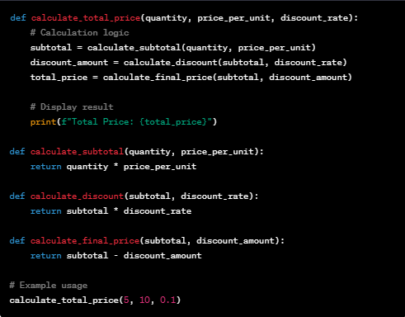
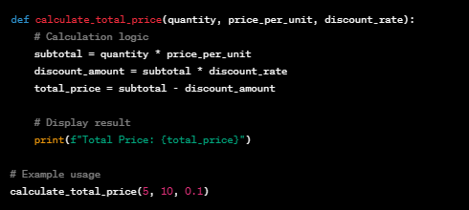
After:
Before:

Slide 19
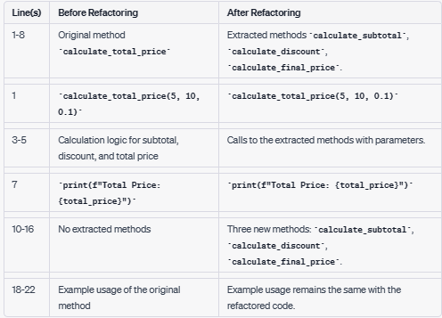
Explanation:

Slide 20
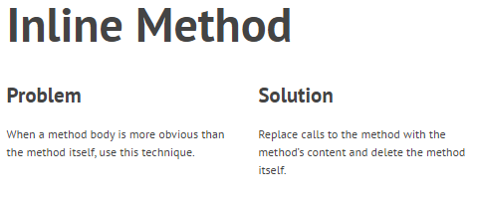
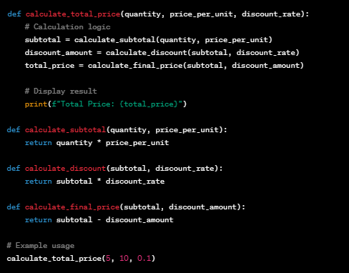
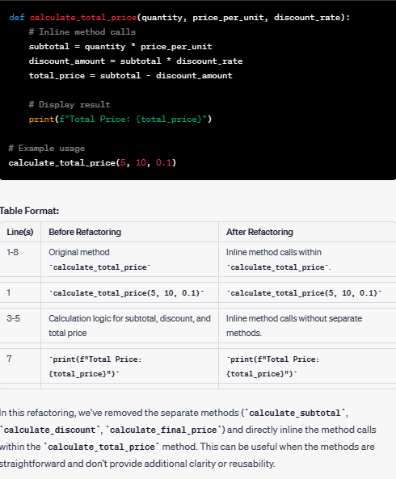
Before:
After:

Slide 21
Explanation:

Slide 22
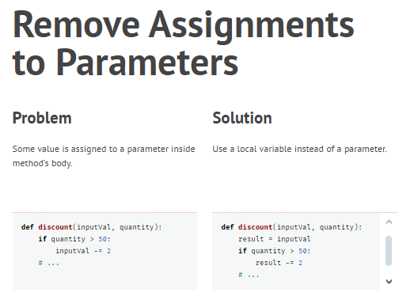
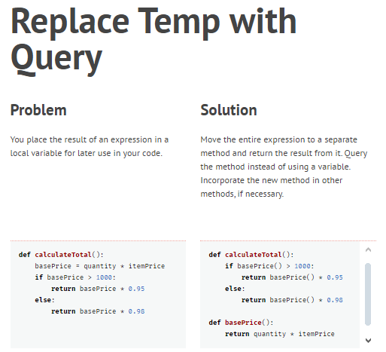

Slide 23
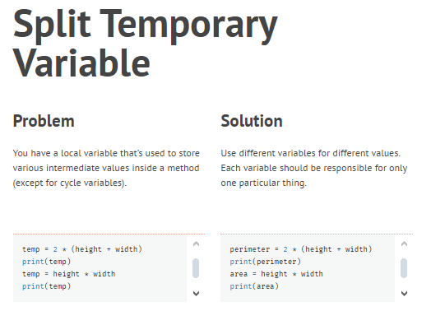
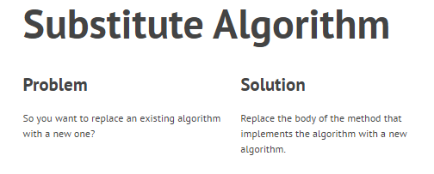
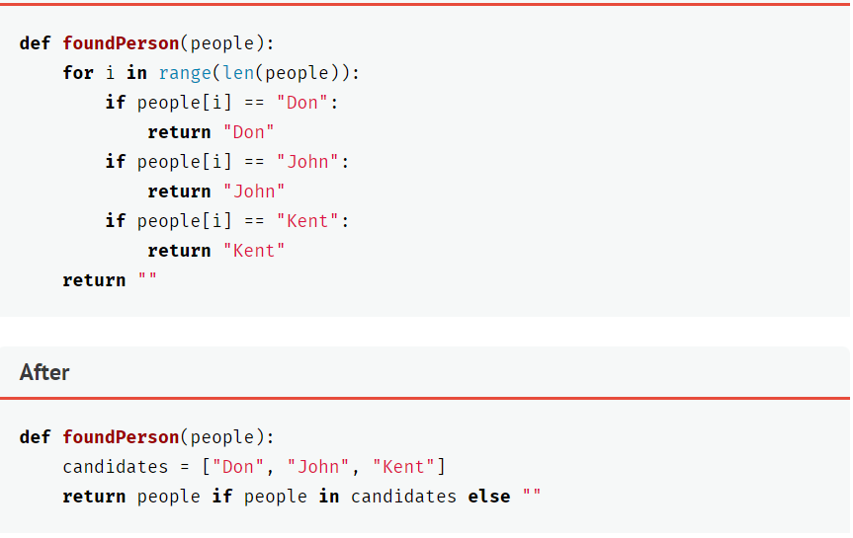
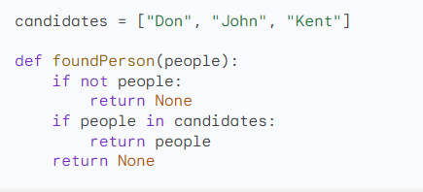

Slide 24

Moving features between objects:

Slide 25
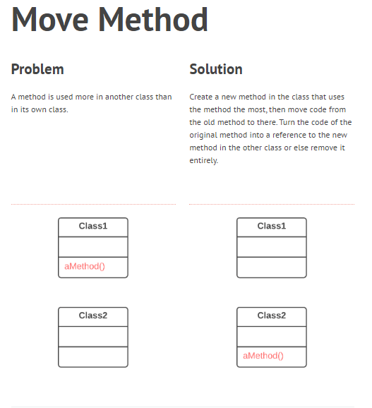
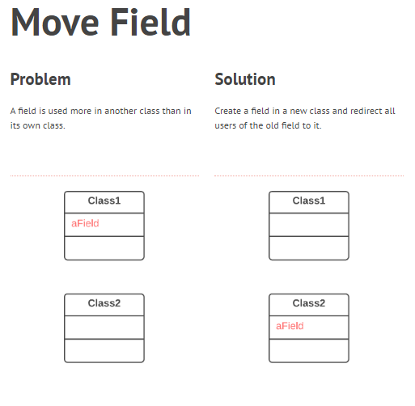

Slide 26
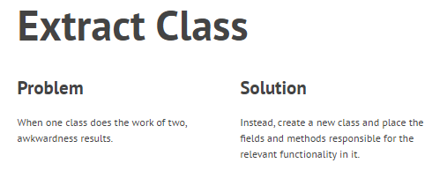
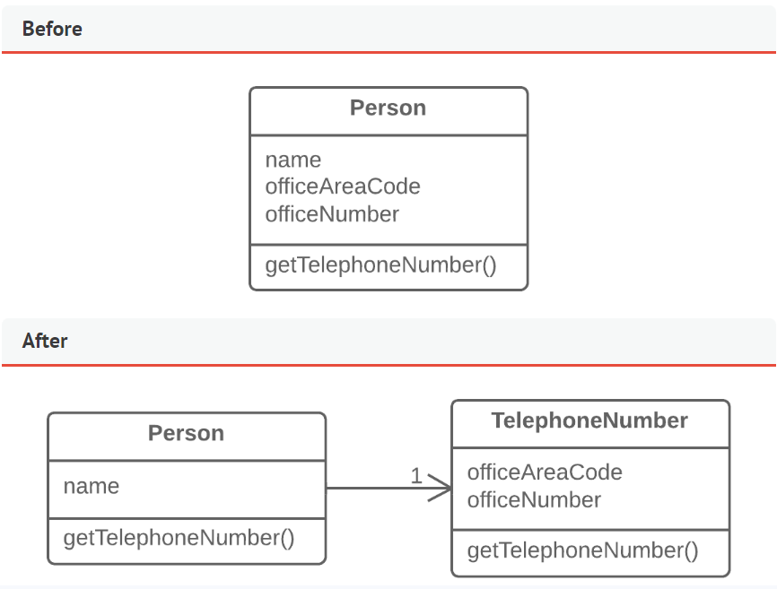

Slide 27
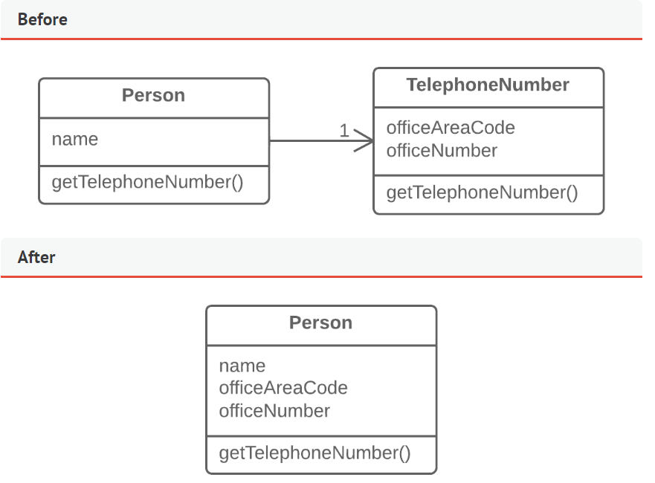
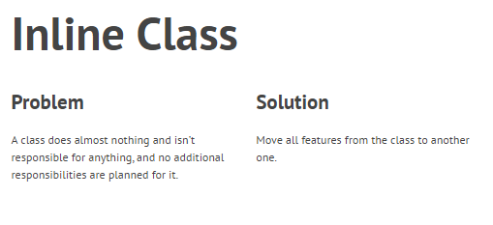

Slide 28
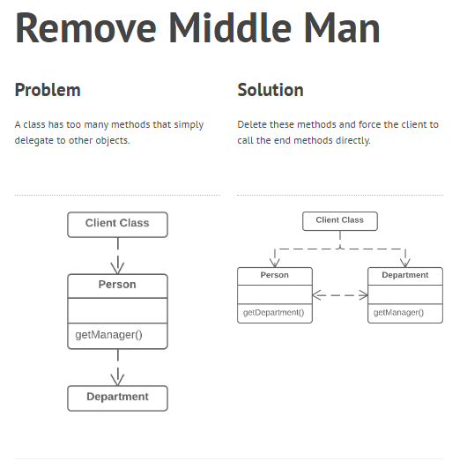

Slide 29

Organizing data

Slide 30
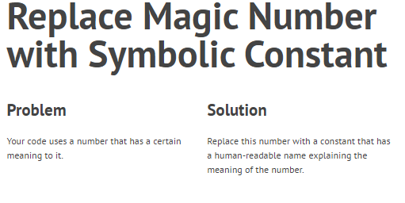
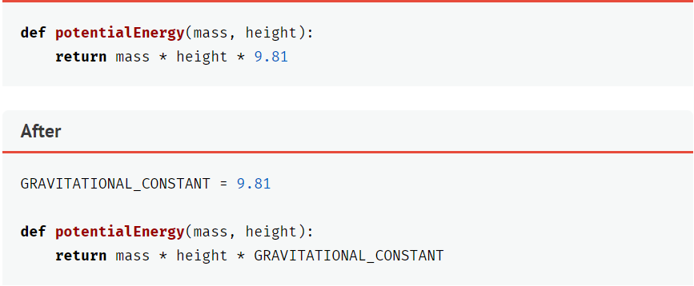

Slide 31

Simplifying method calls

Slide 32
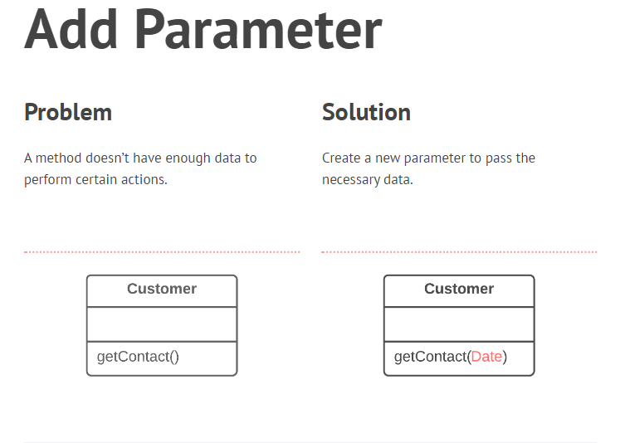
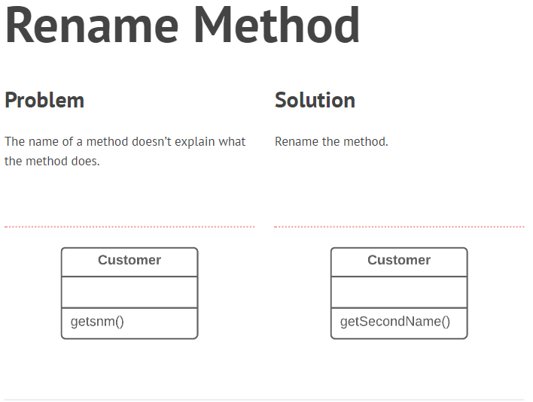

Slide 33
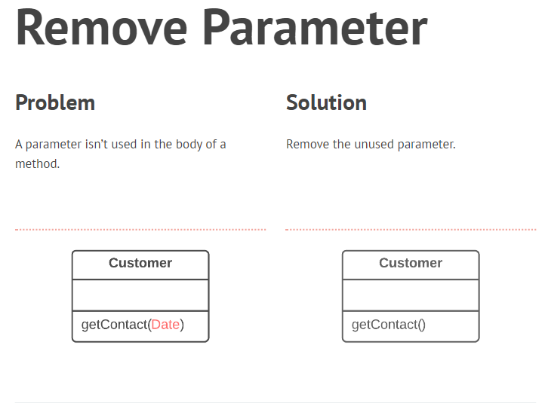
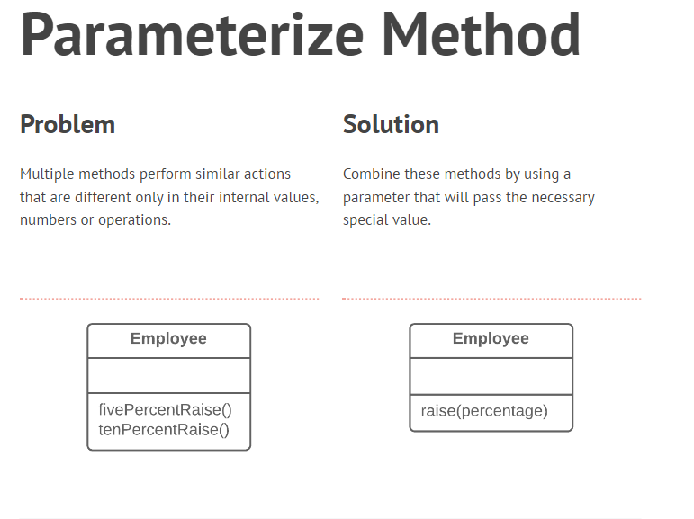
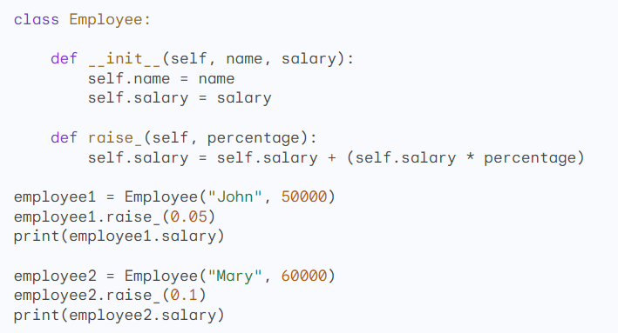

Slide 34
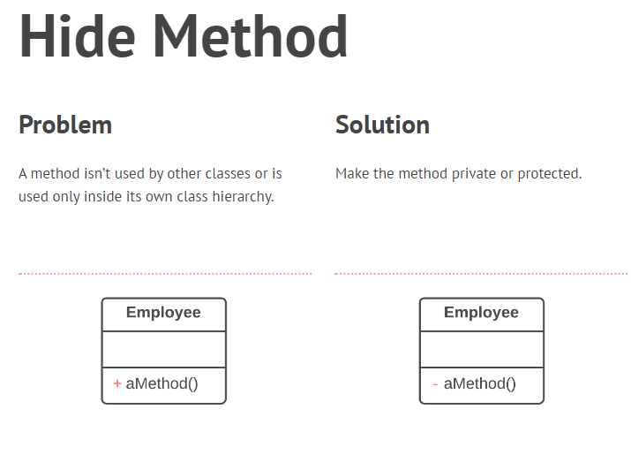

Slide 35
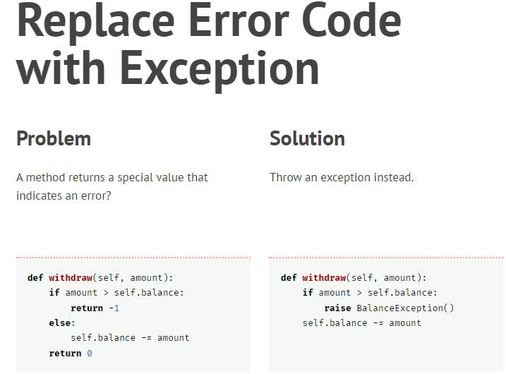

Slide 36

Dealing with generalization:

Slide 37
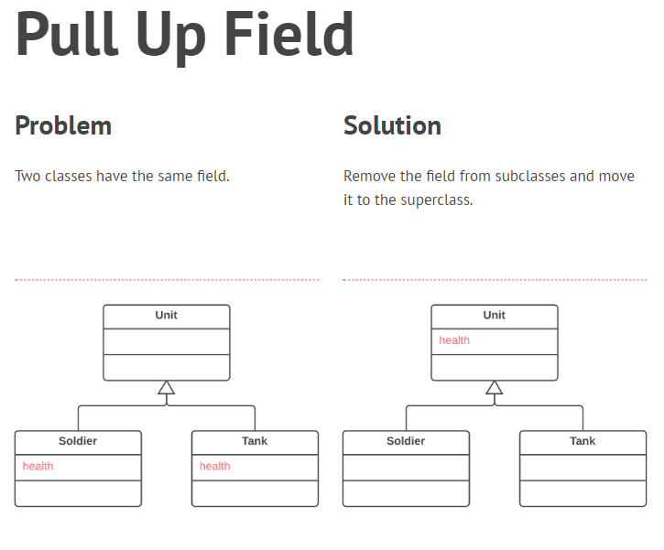
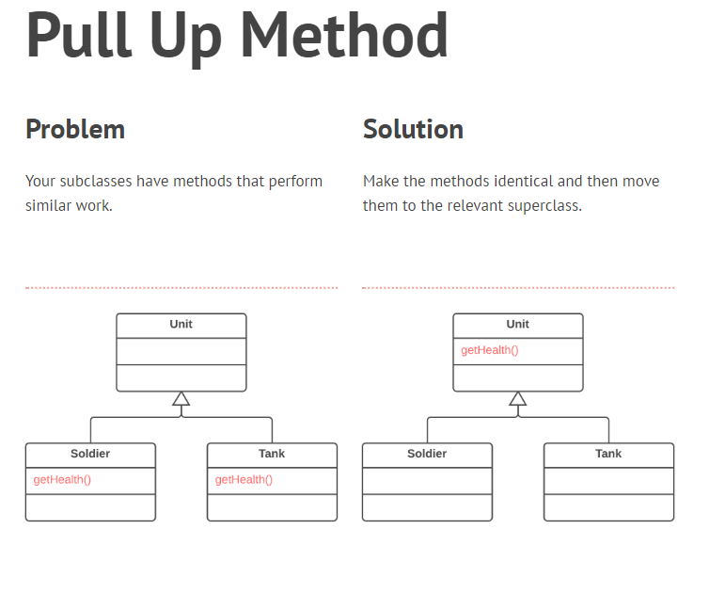

Slide 38
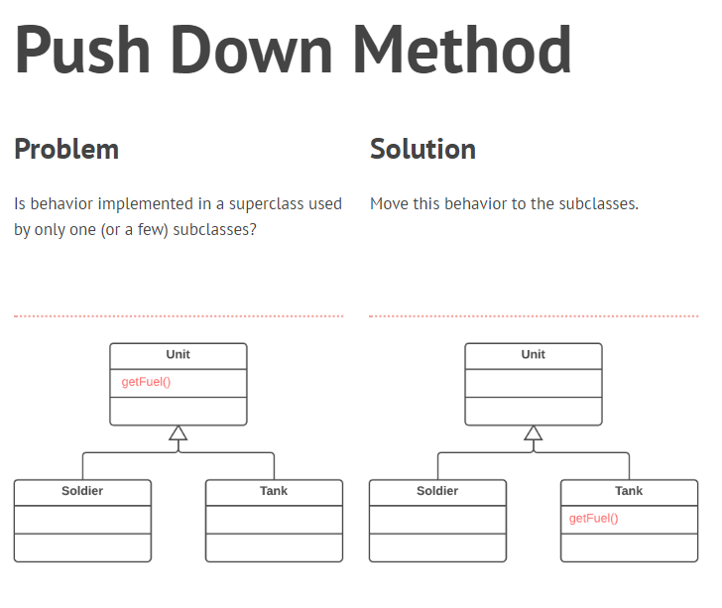
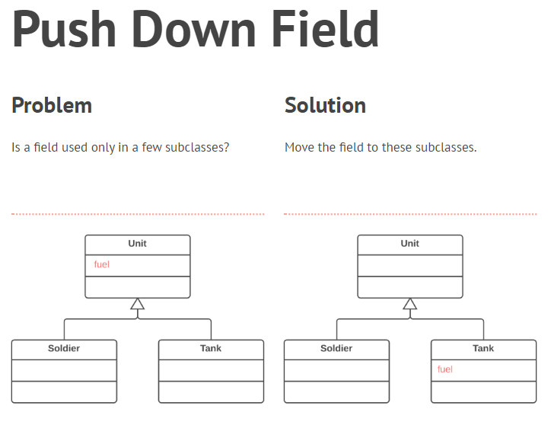

Slide 39
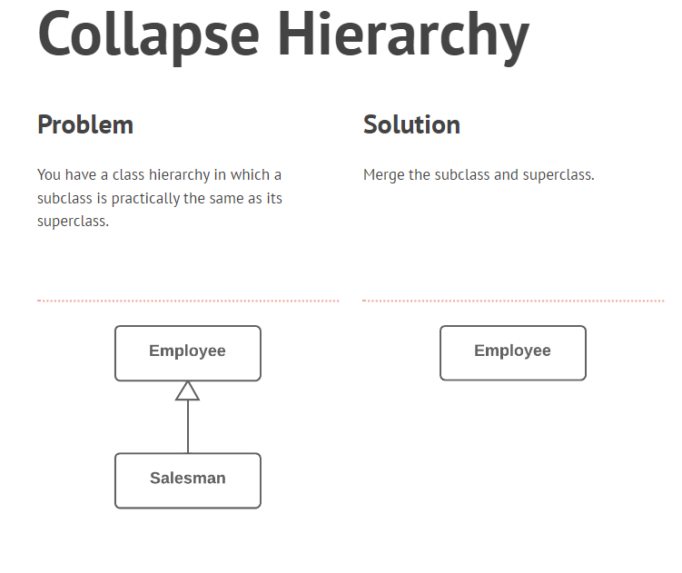

Slide 40
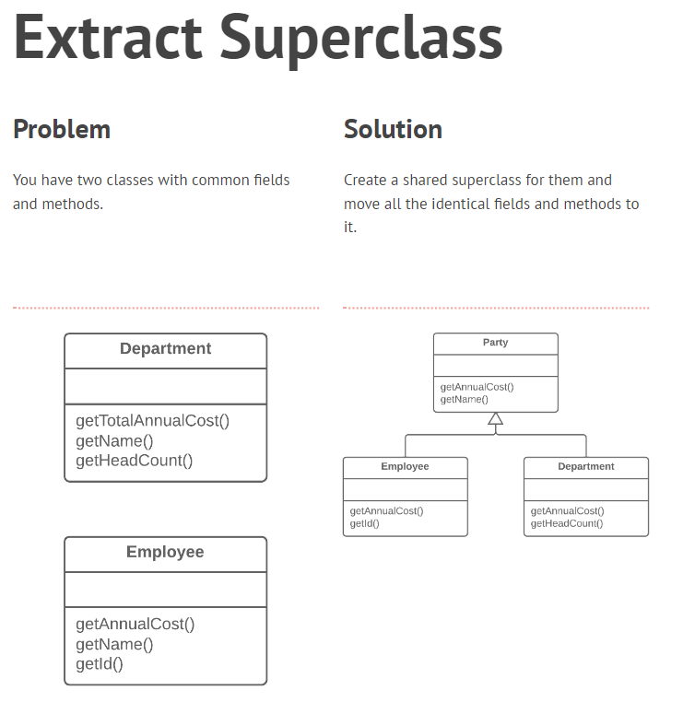

Slide 41
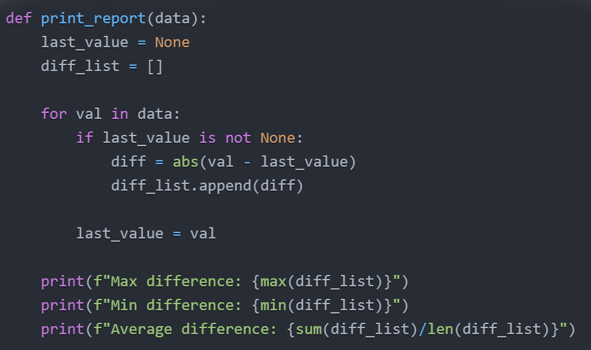
Tasks 1;
Task 1) Refactor this code to remove duplicated logic & make it working code.

Slide 42
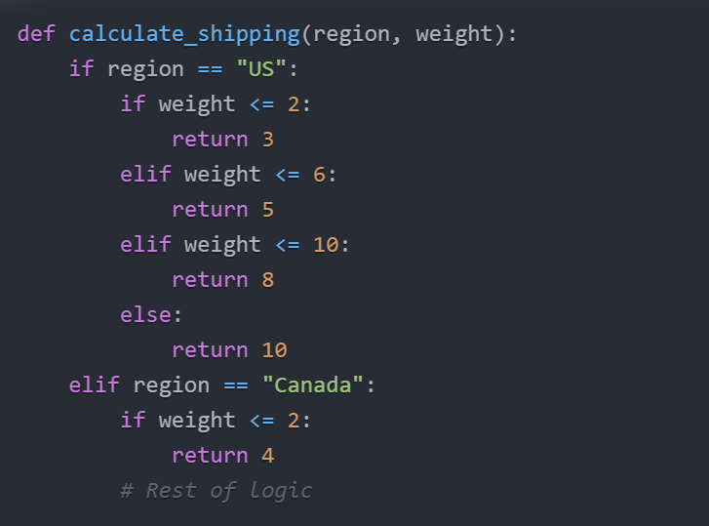
Task 2 ;
Task 2) Refactor this code to simplify the conditional logic & make it working code.

Slide 43
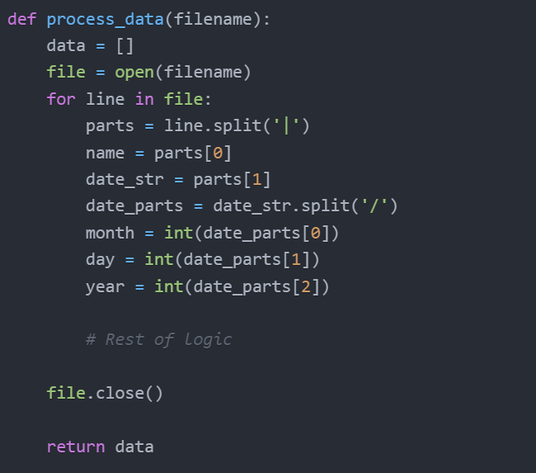
Task 3 ;
Task 3) Identify code smells in the following method and refactor the code to address them. Explain your changes & make it working code.

Slide 44

Task 4 ;
Task 4) Refactor this code to remove duplicate code smell & make it working code.

Slide 45

Task 5 ;
Task 5) Refactor this code to simplify method calls & make it working code.

Slide 46

Task 6 ;
Task 6) Identify code smells in this method and refactor to improve readability and reduce complexity & make it working code.

